Slide 1

Welcome everyone!

Slide 2

Meet the Team
Product Owner:
Daniel Jakubek
Scrum Master:
Sameer Al Harbi
Dev Team:
Alessandro Cavicchioli
Gregor Davis
Scott MacLennan
Adrian Brookes

Slide 3
Plan for today
Quick overview of sprint one and two.
Then we will go over each important story, demo one and have time for feedback.
What will be covered in sprint 3 (backlog).

Slide 4
Last Sprint
Made 18 pages for the goals and homepage.
Admin portal (Only login and vanity)
Map with items relating to Dundee (on the 17 goal pages)
Added general goals to each page.
Overview
This Sprint:
Finished the Admin portal.
Updated the Map to fit feedback.
The Front page has been made more tempting to stay on.
Events have been added to 17 pages together with the contact information.
A list has been added to store locations/Items (can be printed too).

Slide 5
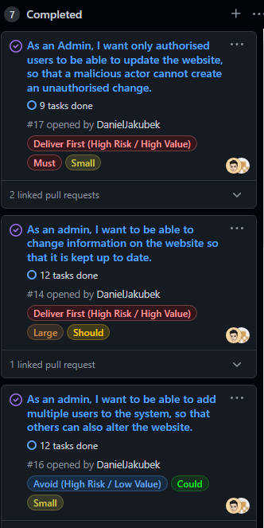
Story 14, 16 and 17
Deal with the admin backend
Have been fully implemented.
Admin can edit, delete exists content on the page.
Only admin can access the editing section.
An admin can add new users to the system.

Slide 6

Questions?

Slide 7
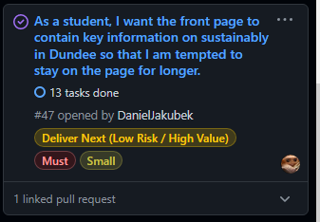
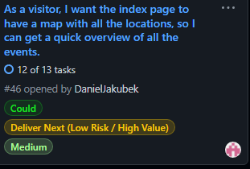
The index page is now in colour and should contain
enough information to tempt the student to stay on the page
A map in now located in the homepage’s footer, this should
give the visitor a quick overview of items

Slide 8
Questions?

Slide 9
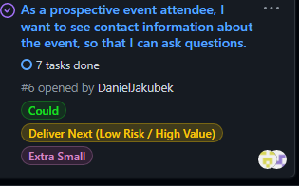
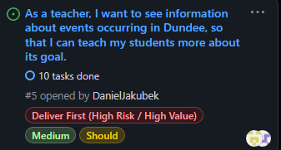
Each goal that has events in Dundee should show them on their respective
page along side the contact information.

Slide 10
Questions?

Slide 11
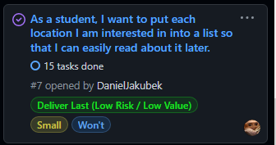
Students can now add each location they are interested into a list.
This list is saved across all the pages and can be printed to pdf or paper.

Slide 12
Questions?

Slide 13
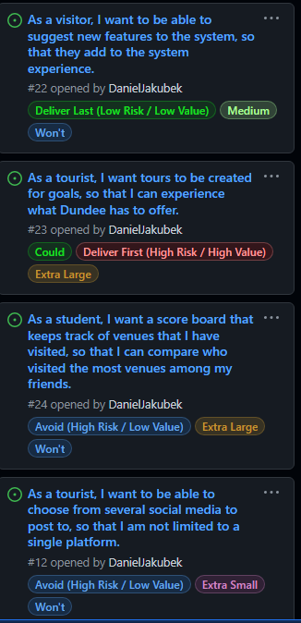
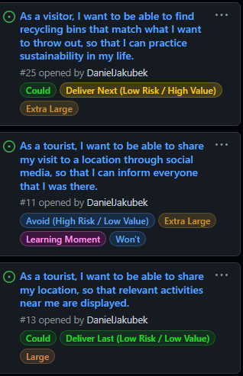
Plans for sprint three

Slide 14


